Slide 1
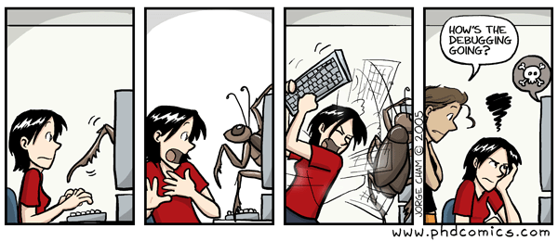
Testing and Debugging

Slide 2
Outline
When things go wrong
Finding errors
Preventing errors
Types of test
Hearts example

Slide 3
When things go wrong
Types of errors
Reading tracebacks
Logical errors

Slide 4
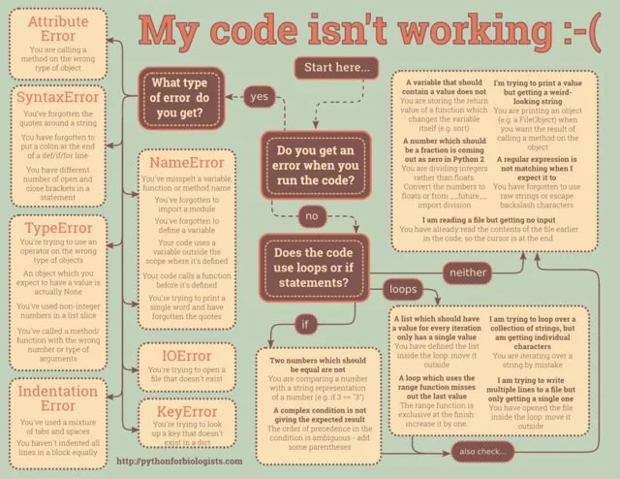

Slide 5
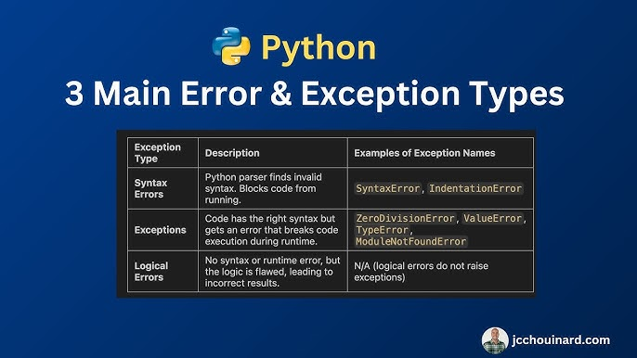
Main Python Error types

Slide 6
Runtime errors
NameError – Function or object does not exist
TypeError – Operation on incompatible data type
IndexError - Index value specified out of range
AttributeError – Attribute does not exist for object type

Slide 7
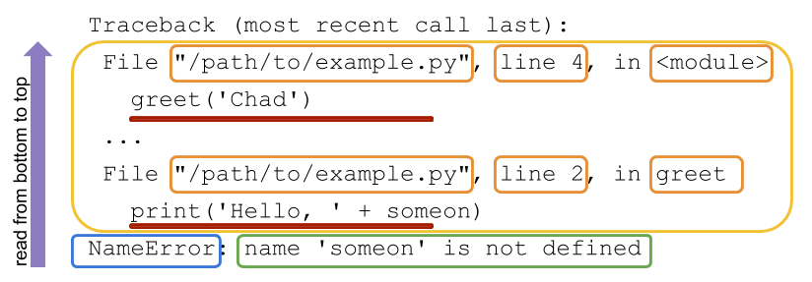
Reading tracebacks
Blue box: Name of exception raised
Green box: Error message with information about the reason an exception was raised
Yellow box: Function calls moving from most recent to least recent, all specifying where the code can be found.
Red underline: Actual code run

Slide 8
Logical errors
Most difficult to catch
Most of the time no errors outputted
Causes:
Flawed algorithms—wrong formulas
Incorrect syntax—code is correct, but wrong operators
Faulty logic—thinking about problem incorrectly
Hearts example

Slide 9
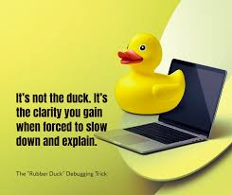
Logical error fixes
Often easiest way is to review code line by line
Another reason for modularity
Ask someone else to review
Rubber duck debugging: Explain code line by line to inanimate object

Slide 10
Finding errors
Assert statements (defensive)
Print statements
Debuggers

Slide 11
Debugging
Options:
Print commands
Breakpoints
Logging
Dedicated debuggers

Slide 12
Assert statements
Key concept of class
Syntax: assert condition, "message if condition is False"
Used for checking arguments
Used for debugging
Used for testing

Slide 13
Print statements
Print values of variables to ensure they are correct
Use f-strings for context
Tracking execution flow:
How far does code get before crashing
Effective placement:
At function entry — did we get here with the right values
At branch points — which path did we take
At loop iterations — are we iterating correctly
At function exit — what are we returning
Do not forget to remove after debugging

Slide 14
Debuggers
Narrowing uncertainty about where something went wrong and why
Basic intuition: Step into code and interact with it
Can set breakpoints to pause code at certain points

Slide 15
Debuggers, part 2
VS Code
PyCharm
juPyter
All have built-in debuggers that make it easy to step into code

Slide 16
Preventing errors
Assert statements again (offensive)
try/except
Distinction between assert and try/except

Slide 17
Assertions
At beginning of functions to check arguments
Example: def calculate_average(numbers): # Precondition: Ensure the list is not empty assert len(numbers) > 0, "List of numbers cannot be empty" return sum(numbers) / len(numbers)

Slide 18
Exceptions
Useful in functions
Anticipating potential errors and specifying what happens if they occur
Do this rather than let the program crash
try…except
try = Run this block of code
Except = if error in try block do this
def safe_convert(value):
try:
return float(value)
except (ValueError, TypeError):
return None

Slide 19
Exceptions, part 2
Use try/except sparingly
Wrap only code that may fail
Catch specific exceptions
Don’t use it for normal logic that can be checked
Log or handle the error meaningfully

Slide 20
Types of testing
Unit testing
Tests of individual functions to ensure they are working
Integration testing
Do functions work together?
Is function output passed correctly between functions
End to end testing
Testing the whole shebang as a user
Regression testing
Did changes break something unexpected?

Slide 21
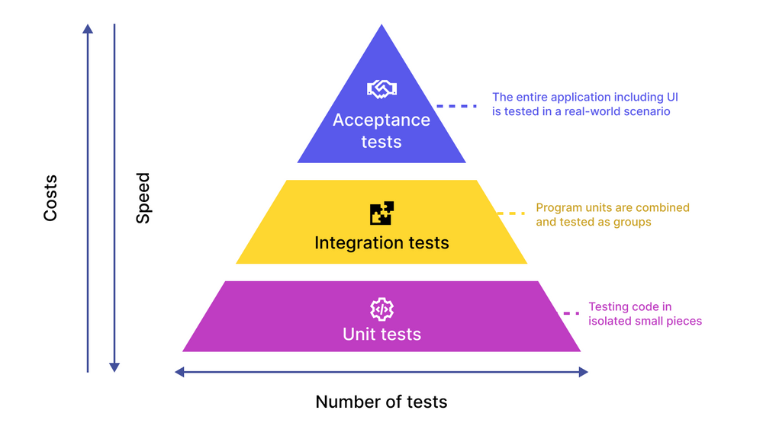

Slide 22
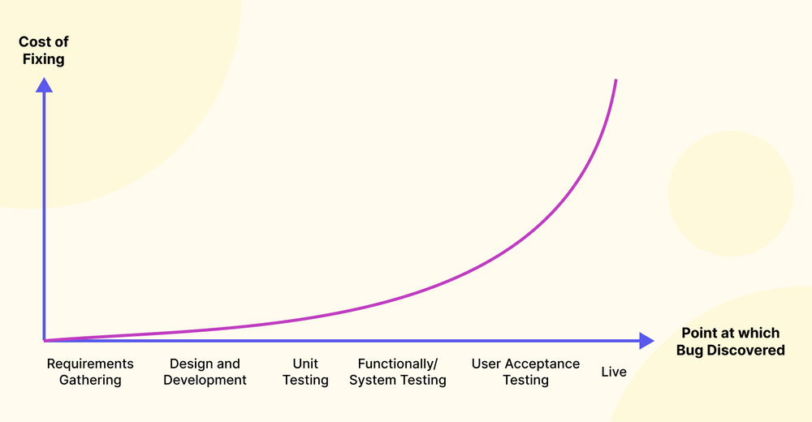

Slide 23
Unit tests
Tests individual components (functions, methods) in isolation
Focuses on smallest testable pieces of code
Helps catch bugs early in development
Typically written by developers during coding
Example: Testing a function that calculates the mean of a vector
Key Idea:
Does this one piece of code work correctly on its own?

Slide 24
Integration tests
Tests how multiple components work together
Focuses on interactions between modules
Detects issues like data flow errors or interface mismatches
Often follows successful unit testing
Example: Testing whether data cleaning output correctly feeds into a model
Key Idea:
Do these pieces of code work correctly when combined?

Slide 25
End to end tests
Tests the entire system from start to finish
Simulates real user workflows
Ensures all components (frontend, backend, data) work together
Often slower but very comprehensive
Example: Running a full pipeline from raw data → analysis → output report
Key Idea:
Does the whole system work as expected in a real scenario?

Slide 26
Regression testing
Ensures that new changes don’t break existing functionality
Re-runs previous tests after updates
Important when modifying or extending code
Often automated using test suites
Example: After updating a function, confirm old results are unchanged
Key Idea:
Did changes accidentally break something that used to work?

Slide 27
Testing packages
unittest
Standard library
Class-based
pytest
User-written package (install with pip)
Function-based

